Slide 1

HEALTHCARE COST PREDICTION
Med-Minds
o Prabhleen Kaur (0857194)
o Rajwinder Kaur (0831280)
o Ajay Haji Korbe (0852660)
o Thrivikram Sai Teja (0856337)

Slide 2
TABLE OF CONTENTS
INTRODUCTION
PROBLEM STATEMENT
DATA OVERVIEW
METHODOLOGY
EDA
DASHBOARDS
RESULTS
CHALLENGES
RECOMMENDATIONS
CONCLUSION
PROJECT GOAL

Slide 3
INTRODUCTION
Our project, Med Minds focuses on analyzing patient cost data in Canada across all the provinces
Understanding healthcare cost is critical for improving resource allocation.
Healthcare is a basic need nowadays that should be fair and equal for all. No matter how much money we have, everyone should have access to good healthcare.
Aim: Identify cost patterns and cost-saving opportunities in Canadian healthcare

Slide 4

PROBLEM STATEMENT
This project aims to analyze healthcare cost patterns in Canada based on jurisdictions, age groups, and medical cases, and to build a predictive model to estimate individual patient costs.
The goal is to support data-driven decisions for resource allocation and cost management in the healthcare system.

Slide 5
PROJECT GOAL
Analyze patient cost data from CIHI (2017–2022) to uncover trends and patterns.
1
Identify key cost drivers across age groups, case mix groups, and jurisdictions.
2
Use exploratory data analysis (EDA) to understand data distribution.
3
Apply machine learning models to predict patient care costs.
4
Provide actionable insights and recommendations for cost optimization in the Canadian healthcare system.

Slide 6

DATA OVERVIEW
Dataset covers years 2017 to 2022
Source: Canadian Institute for Health Information dataset.
Key variables: Age, length of stay, diagnosis codes, geographic region, cost of hospital and physician.

Slide 7
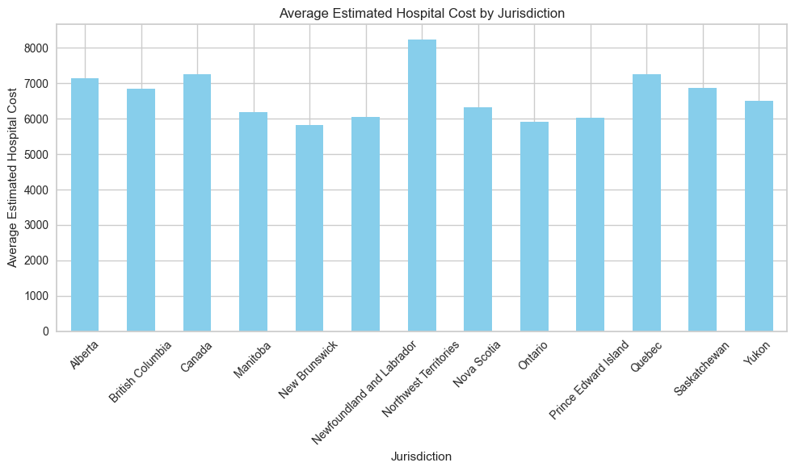
EXPLORATORY DATA ANALYSIS
The following chart depicts average estimated hospital cost for different jurisdictions.
Newfoundland shows the highest estimated hospital cost compared to other provinces.

Slide 8
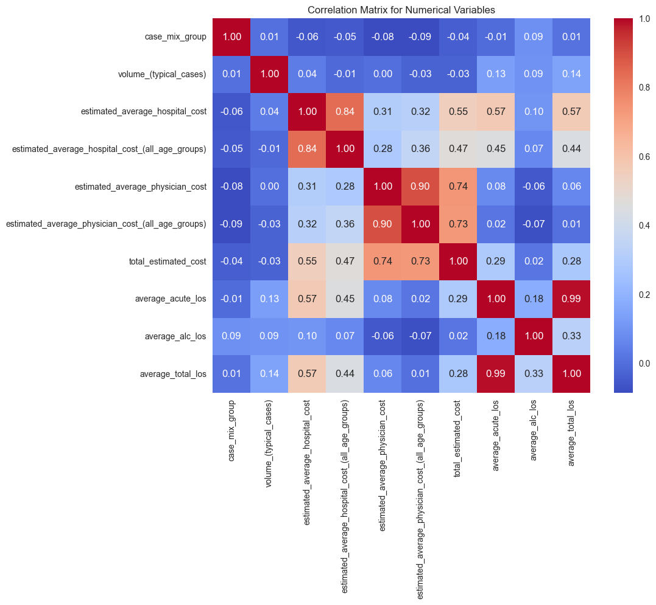
We also created a heatmap to show the correlation matrix, which helped us quickly identify which features had strong or weak relationships with each other.

Slide 9
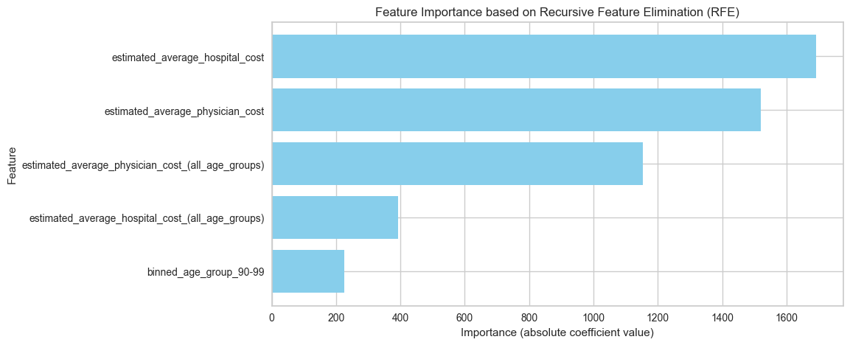
FEATURE SELECTION
Feature selection was performed using both Recursive Feature Elimination (RFE) and embedded methods to identify the most relevant predictors for our model. This helped in improving model performance and interpretability by eliminating less important variables.

Slide 10
MODEL BUILDING
To predict the total estimated cost of healthcare, a Random Forest Regression model was developed
The target variable was total estimated cost
PyCaret’s regression module was used to perform feature selection
Metric | Value
R-square | 0.99
MSE | 707

Slide 11
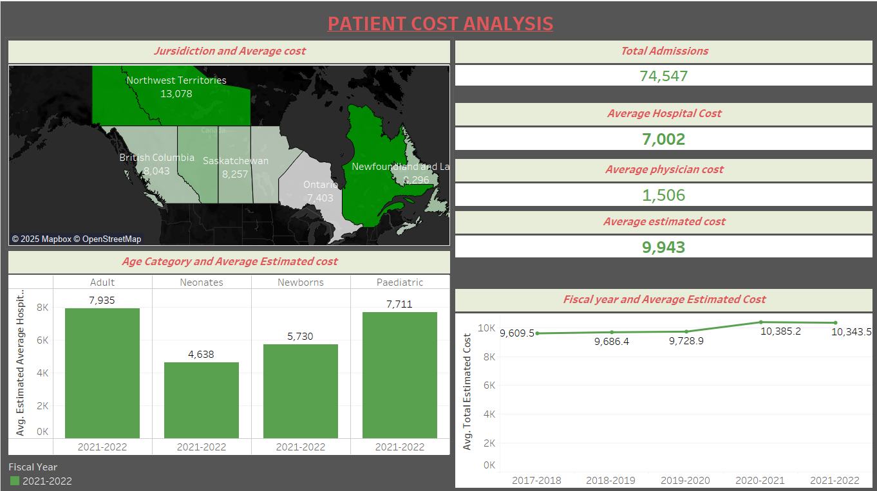

Slide 12
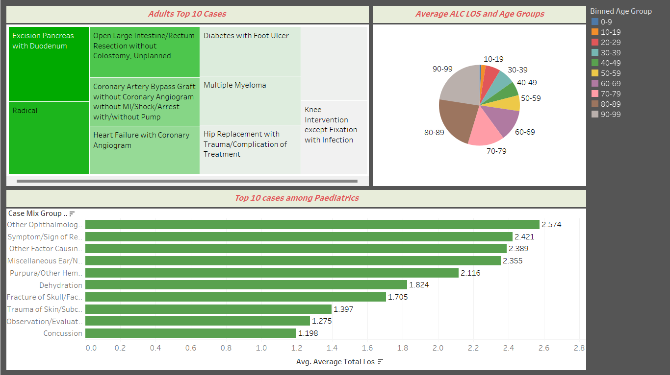

Slide 13
MODEL DEPLOYMENT
After training and evaluating our predictive model, we proceeded with deployment to demonstrate its practical use
We created a user-friendly interface using flask, which allows healthcare professionals or analysts to input relevant patient data such as age, medical case, and length of stay and receive a predicted cost estimate in real-time.
This step showcases how machine learning can be integrated into real-world applications, making data-driven decision-making more accessible

Slide 14
CHALLENGES FACED
Encountered inconsistent data, requiring extensive preprocessing
Navigated complex medical codes that required careful interpretation
Managed outliers and skewed cost distributions that could impact model performance
Worked within time constraints for model development, testing, and reporting

Slide 15
RECOMMENDATIONS
Implement targeted cost-control measures in high-cost regions like the Northwest Territories through telemedicine and resource optimization.
Enhance preventive care programs for adults to reduce the incidence of costly chronic conditions like diabetes and heart disease.
Invest in pediatric outpatient and community care to reduce hospital length of stay for common conditions.
Standardize treatment protocols across jurisdictions to minimize regional cost variations and ensure equitable care.
Monitor and analyze cost trends annually to proactively adjust healthcare funding and resource allocation.

Slide 16
CONCLUSION
By integrating machine learning models, we improved the accuracy of cost prediction and uncovered meaningful patterns.
These insights offer valuable support for strategic healthcare decision-making and highlight the potential of data-driven methods to enhance efficiency and optimize resource allocation across hospital systems.

Slide 17

THANK YOU

